Slide 1
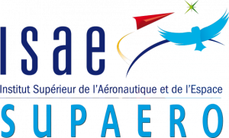
Masters of Aerospace Engineering Research Project
Manufacturing Constraints in Topology Optimization Framework
By:
Prajwal Karinja Haridas
Tutors:
Joseph Morlier
Simone Coniglio

Slide 2
Topology Optimization
Structural Topology optimization is a particular method that aims at optimizing the distribution of material in any specific design domain for given set of loads, constraints such that certain properties like compliance, stress bearing ability are optimized.
In topology optimization, the shape or size of the structure is not fixed.
There are many approaches for structural topology optimization and it has been extended to wide range of physical disciplines such as acoustics, electromagnetics and optics.
Topology optimization has already been implemented in commercial software to solve practical design optimization problems.

Slide 3
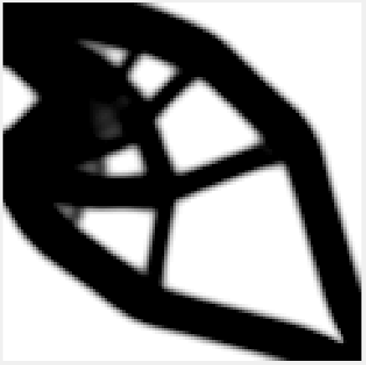
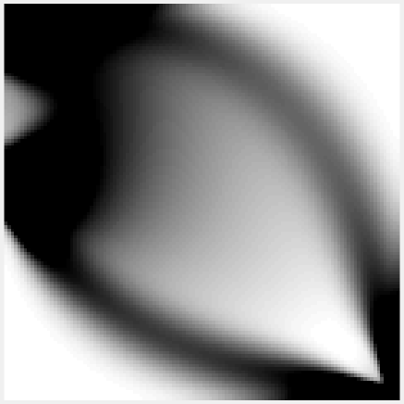
Different Approaches
Solid Isotropic Material with Penalization (SIMP)
This method uses penalization which makes the intermediate densities smaller.
The value of this penalty is generally p ≥ 3 and changed accordingly.
This penalty factor p, increase the cost of intermediate density elements and decrease the number of intermediate density elements.
Applying penalty of p=3, the grey area is reduced significantly

Slide 4
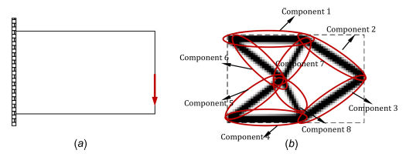
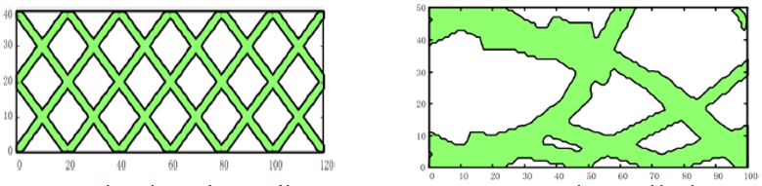
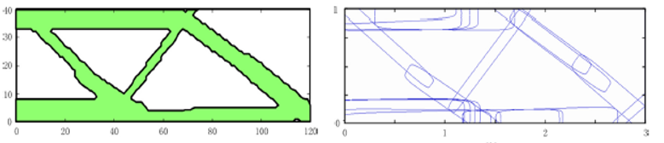
Different Approaches
Moving Morphable Components (MMC)
In this method morphable components are used as primary building blocks.
It inherits from level set method, where the value is positive inside the domain, zero on boundary and negative outside.
One continuous path is taken as a component and are allowed to overlap.
Initial to final solution stages

Slide 5
Different Approaches
Moving Node Approach(MNA)
In this method the structures are optimized by varying different parameters such as the length, thickness, orientation, location and connectivity between components.
The main thought process for this method is to reduce the number of input variables and also to minimize the degrees of freedom.
In this the density is determined by the position of the mass containing nodes.
This is a ‘flow-like’ approach where the material moves towards a more optimal distribution.
The local density is then computed and the densities are summed to find the total density between components.

Slide 6
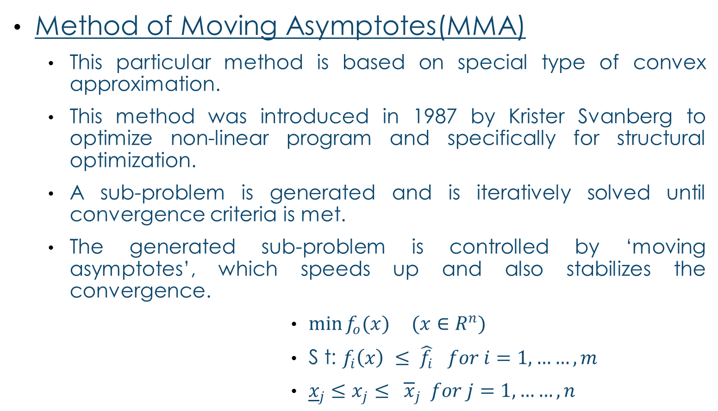
Different Approaches
Method of Moving Asymptotes(MMA)
This particular method is based on special type of convex approximation.
This method was introduced in 1987 by Krister Svanberg to optimize non-linear program and specifically for structural optimization.
A sub-problem is generated and is iteratively solved until convergence criteria is met.
The generated sub-problem is controlled by ‘moving asymptotes’, which speeds up and also stabilizes the convergence.
$\min{f_{o}(x)} (x∈R^{n})$
S t: $f_{i}\left(x\right) ≤ \hat{f_{i}} for i=1,……,m$
${\underline{x}}_{j}≤x_{j}≤ {\overline{x}}_{j} for j=1,……,n$

Slide 7
Application to Manufacturing process
Molding
It is a process of manufacturing by shaping liquid or pliable raw material using a rigid frame called mold.
This itself may have been made using the final object.
Milling
It is the process of machining using rotary cutters to remove material by moving the tool in to the workpiece.
The milling tool generates very high temperature during operation.
Casting
In this process, a molten material is poured into the mold containing the cavity of the final desired shape and finally solidified.
It is then the mold is broken and the cast product is removed.

Slide 8
About the project
Objective
The main objective is to use the topology optimization on the manufacturing process by defining its constraints
Milestones
The Bibliography of the project has been initiated(Mar-Apr 19)
Realizing the constraints for different manufacturing process. (Apr 19)
Further study has to be made on the particular problem of the constraints. (Apr-May 19)
Better understanding of the MATLAB code and also its implementation.(Apr-May 19)
Finalizing on the method which will be best suited based on constraints.(May 19)
Translating the constraints of this problem on to the optimizer.(June 19)

Slide 9
References
Bendsoe, M. P., and Kikuchi, N., 1988, “Generating Optimal Topologies in Structural Design Using a Homogenization Method”, Computer methods in applied mechanics and engineering 71.2 (1988): 197-224.
Guo, Xu., Zhang, Weisheng., Zhong, Wenliang., (August 2014). “Doing Topology Optimization Explicitly and Geometrically—A New Moving Morphable Components Based Framework”, Journal of Applied Mechanics, Journal of Applied Mechanics 81.8 (2014): 081009.
Kong-Tian Zuo, Li-Ping Chen, Yun-Qing Zhang, Jingzhou Yang.(May 2005)- Manufacturing- and machining-based topology optimization, The international journal of advanced manufacturing technology 27.5-6 (2006): 531-536.
Krister Svanberg (1987) - THE METHOD OF MOVING ASYMPTOTES-A NEW METHOD FOR STRUCTURAL OPTIMIZATION, International journal for numerical methods in engineering 24.2 (1987): 359-373 .
Johannes T B Overvelde (April 2012) – The Moving Node Approach in Topology Optimization.
Erik Andreassen, Anders Clausen, Mattias Schevenels, Boyan S Lazarov, Ole Sigmund (Nov 2010) - Efficient topology optimization in MATLAB using 88 lines of code, Structural and Multidisciplinary Optimization 43.1 (2011): 1-16

Slide 10
Thank you!

